Slide 1
Chapter 17 – Overlapping Objects and Sematic Segmentation

Slide 2
In This Chapter
Overlapping objects
Anchor boxes
Transposed convolution
Deep learning for semantic segmentation
U-Net

Slide 3
Overlapping Objects
Anchor Boxes

Slide 4
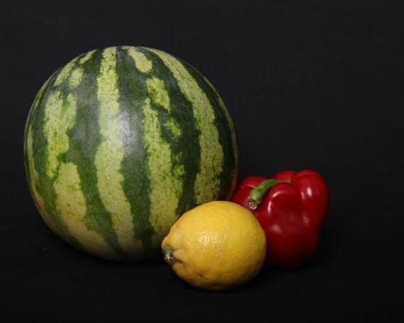
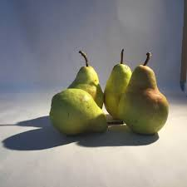
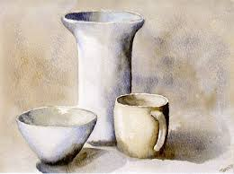
Overlapping Objects
Overlapping objects may cause confusing effects in their detection and putting bounding boxes around them.

Slide 5
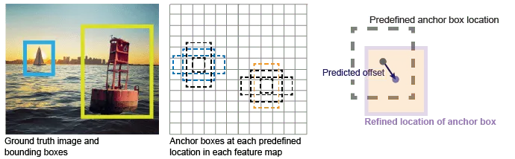
Anchor Boxes as Templates for Bounding Boxes

Slide 6
Bounding Boxes
A bounding box is a rectangular region that is used to enclose an object or a specific region of interest within an image.
It is represented by four coordinates: (x_min, y_min) representing the top-left corner, and (x_max, y_max) representing the bottom-right corner of the rectangle.
Bounding boxes are used to localize objects within an image and are commonly annotated in object detection datasets to provide ground-truth information about the object’s location.

Slide 7
Anchor Boxes
Anchor boxes, also known as anchor priors or default boxes, are pre-defined bounding boxes with specific sizes, aspect ratios, and positions that are used as reference templates during object detection.
These anchor boxes are placed at various positions across an image, often in a grid-like pattern, to capture objects of different scales and shapes.
During training and inference, anchor boxes are used to predict the locations and shapes of objects relative to these reference boxes.
https://medium.com/@nikitamalviya/object-detection-anchor-box-vs-bounding-box-bf1261f98f12

Slide 8
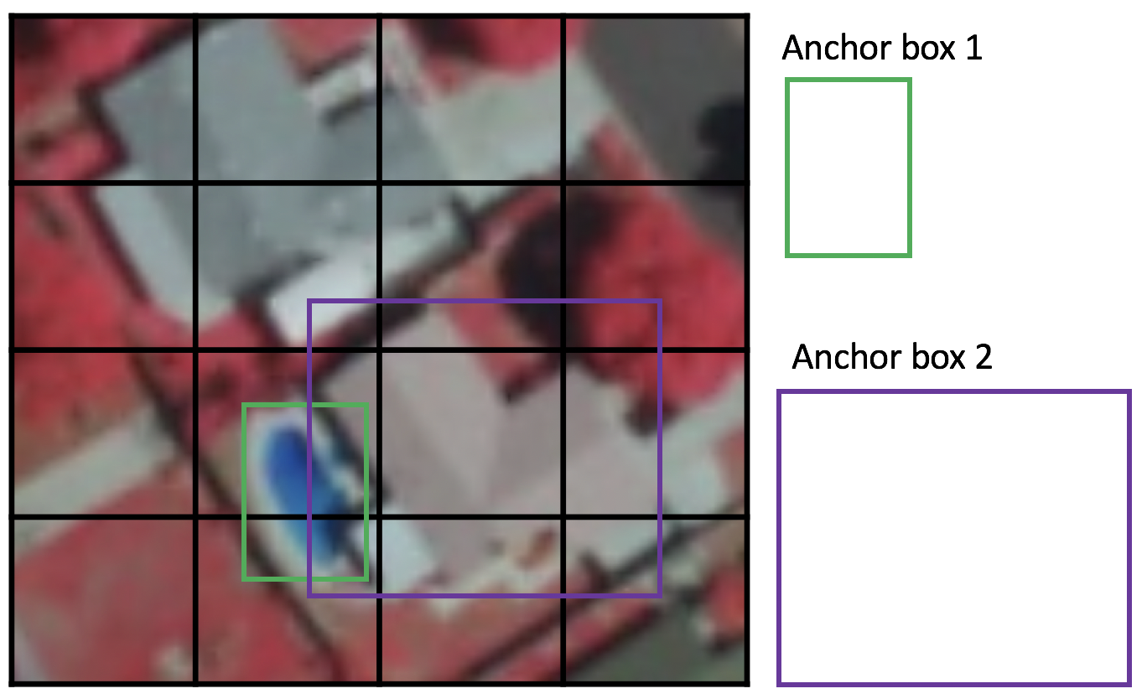
Example of Anchor Boxes
https://developers.arcgis.com/python/guide/how-ssd-works/

Slide 9
Anchor Boxes vs Bounding Boxes
Bounding boxes are provided as annotations in object detection datasets, representing ground-truth object locations.
Anchor boxes are used as templates for prediction during model training and inference.
The model predicts adjustments to anchor boxes to match objects' actual locations.
Anchor boxes eliminate the need to scan an image with a sliding window that computes a separate prediction at every potential position.
Examples of detectors that use a sliding window are those that are based on aggregate channel features (ACF) or histogram of gradients (HOG) features.

Slide 10
Key Differences
Category | Bounding Boxes | Anchor Boxes
Definition and Purpose: | Bounding boxes represent the actual regions in an image that enclose objects of interest. | Anchor boxes are reference bounding boxes used to predict object locations and shapes during object detection.
Annotating vs. Predicting: | Bounding boxes are provided as annotations in object detection datasets, representing ground-truth object locations. | Anchor boxes are used as templates for prediction during model training and inference. The model predicts adjustments to anchor boxes to match objects’ actual locations.
Static vs. Adaptive: | Bounding boxes are static and determined by annotators based on the object’s true boundaries. | Anchor boxes are adaptable and can be designed with different scales and aspect ratios to handle various object sizes and shapes.
Localization vs. Reference: | Bounding boxes are used for object localization and are compared to predicted boxes to measure accuracy. | Anchor boxes serve as reference points for predicting object locations and shapes.

Slide 11
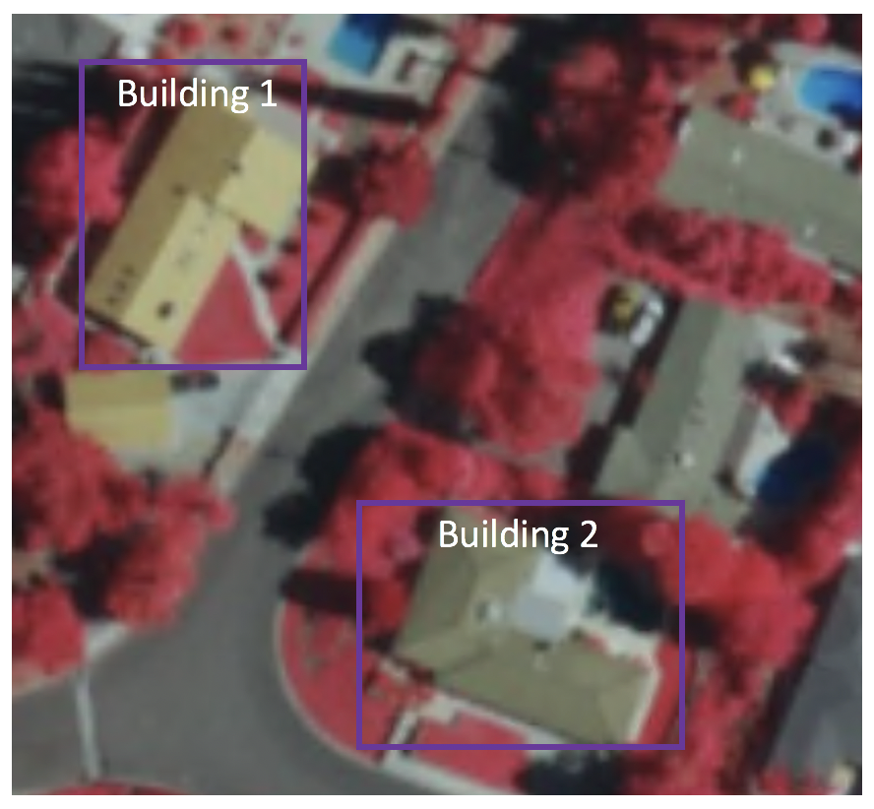
Aspect Ratio
Not all objects are square in shape.
Some are longer and some are wider, by varying degrees.
The SSD architecture allows pre-defined aspect ratios of the anchor boxes to account for this.
The ratios parameter can be used to specify the different aspect ratios of the anchor boxes associates with each grid cell at each zoom/scale level.

Slide 12
Receptive Field (1/3)
Receptive field is defined as the region in the input space that a particular CNN’s feature is looking at (i.e. be affected by).
We will use "feature" and "activation" interchangeably here and treat them as the linear combination (sometimes applying an activation function after that to increase non-linearity) of the previous layer at the corresponding location.
Because of the the convolution operation, features at different layers represent different sizes of region in the input image.
As it goes deeper, the size represented by a feature gets larger. In this example below, we start with the bottom layer (5x5) and then apply a convolution that results in the middle layer (3x3) where one feature (green pixel) represents a 3x3 region of the input layer (bottom layer).

Slide 13
Receptive Field (2/3)
And then apply the convolution to middle layer and get the top layer (2x2) where each feature corresponds to a 7x7 region on the input image.
These kind of green and orange 2D array are also called feature maps which refer to a set of features created by applying the same feature extractor at different locations of the input map in a sliding window fashion.
Features in the same feature map have the same receptive field and look for the same pattern but at different locations.
This creates the spatial invariance of ConvNet.

Slide 14
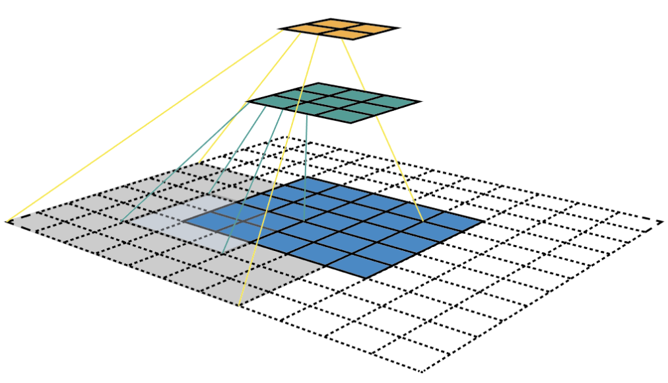
Receptive Field (3/3)

Slide 15
Anchor Box Algorithm
Previously
Each object in training image is assigned to grid cell that contains that object’s midpoints.
Output 3 x 3 x 8
With two anchor boxes
Each object in training image is assigned to grid cell that contains object midpoint and anchor box for the grid cell with highest IoU.
Output a 3 x 3 x 16
3 x 3 x 2 x 8

Slide 16
How are Anchor Boxes Generated
For example, we can decide that we want an anchor box of size 16x16, with two types of aspect ratio: 1:1, 1:2, and 2:1, and with 2 types of scale: x1, and x2.
This means we end up with 6 anchor boxes per region:
16x16 - the 1:1 box of scale 1
16x32 - The 1:2 box of scale 1
32x16 - The 2:1 box of scale 1
32x32 - The 1:1 box of scale 2
32x64 - The 1:2 box of scale 2
64x32 - The 2:1 box of scale 2
Now, practically, how are these anchor boxes generated?
For that, we must first get into the object detection algorithm we're using.
For example, the network is going to generate a set of possible locations for our objects.
At these locations, we can regress our anchor boxes.

Slide 17
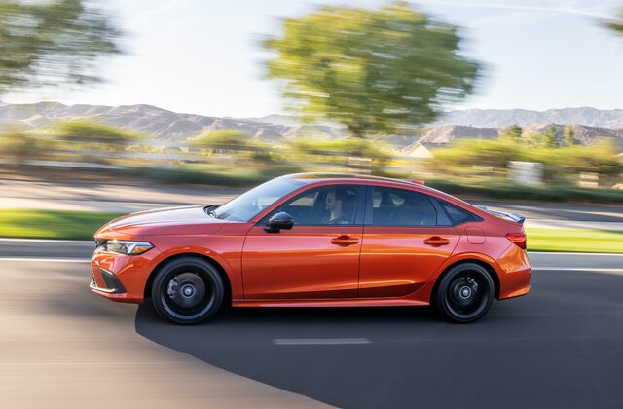
Anchor Box Example
Pc
x_min
y_min
x_max
y_max
c₁
c₂
c₃
Pc
x_min
y_min
x_max
y_max
c₁
c₂
c₃
1
x_min
y_min
x_max
y_max
c₁
c₂
c₃
1
x_min
y_min
x_max
y_max
c₁
c₂
c₃
0
?
?
?
?
?
?
?
1
x_min
y_min
x_max
y_max
c₁
c₂
c₃
Anchor box 1
Anchor box 1 Anchor box 2
Anchor box 2
Center points of the Anchor boxes

Slide 18
Bounding Box Prediction

Slide 19
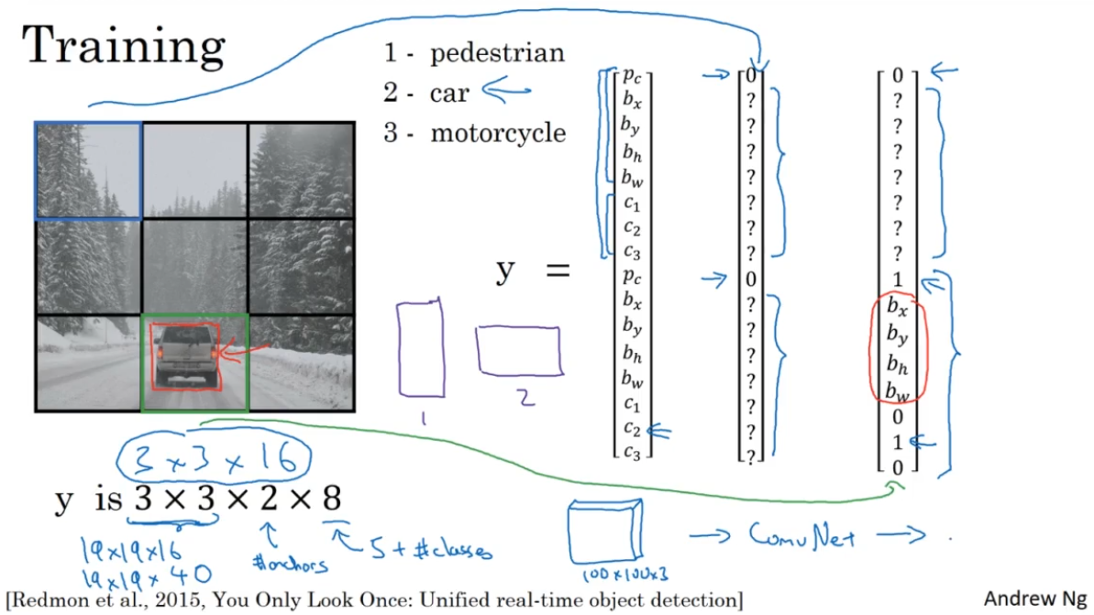
Training

Slide 20
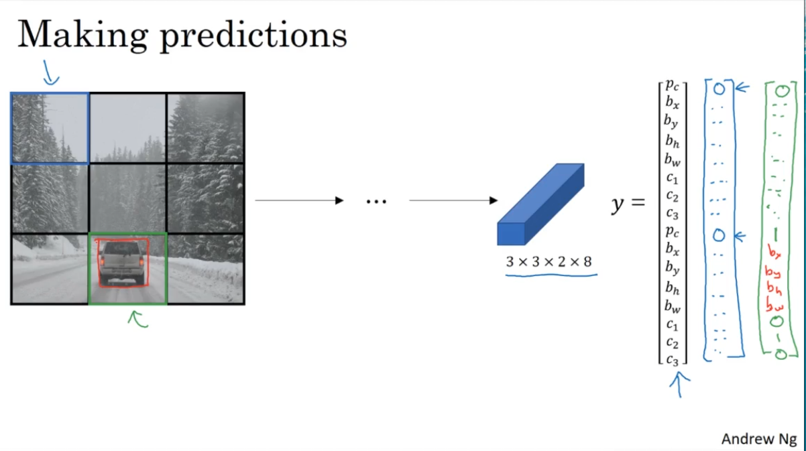
Making Predictions

Slide 21
R-CNN -- Region Proposal
Region-based Convolutional Neural Network (R-CNN) is a type of deep learning architecture used for object detection in computer vision tasks (2014).
RCNN was one of the pioneering models that helped advance the object detection field by combining the power of convolutional neural networks and region-based approaches.
R-CNN starts by dividing the input image into multiple regions or subregions.
These regions are referred to as "region proposals" or "region candidates."
The region proposal step is responsible for generating a set of potential regions in the image that are likely to contain objects.
R-CNN does not generate these proposals itself; instead, it relies on external methods like Selective Search or EdgeBoxes to generate region proposals.

Slide 22
Regional Proposal: R-CNN (1/4)
Object detection aids in pose estimation, vehicle detection, surveillance etc.
The difference between object detection algorithms and classification algorithms is that in detection algorithms, we try to draw a bounding box around the object of interest to locate it within the image.
Also, you might not necessarily draw just one bounding box in an object detection case, there could be many bounding boxes representing different objects of interest within the image and you would not know how many beforehand.

Slide 23
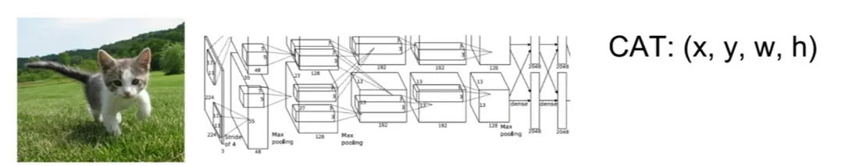
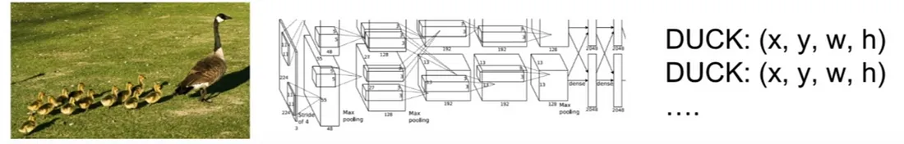
Regional Proposal: R-CNN (2/4)
https://towardsdatascience.com/r-cnn-fast-r-cnn-faster-r-cnn-yolo-object-detection-algorithms-36d53571365e

Slide 24
Regional Proposal: R-CNN (3/4)
The major reason why you cannot proceed with this problem by building a standard convolutional network followed by a fully connected layer is that, the length of the output layer is variable — not constant, this is because the number of occurrences of the objects of interest is not fixed.
A naive approach to solve this problem would be to take different regions of interest from the image and use a CNN to classify the presence of the object within that region.
The problem with this approach is that the objects of interest might have different spatial locations within the image and different aspect ratios.
Hence, you would have to select a huge number of regions, and this could computationally blow up.
Therefore, algorithms like R-CNN, YOLO etc have been developed to find these occurrences and find them fast.

Slide 25
Regional Proposal: R-CNN (4/4)
To bypass the problem of selecting a huge number of regions, Ross Girshick et al. proposed a method where we use selective search to extract just 2000 regions from the image and he called them region proposals.
Therefore, now, instead of trying to classify a huge number of regions, you can just work with 2000 regions.
These 2000 region proposals are generated using the selective search algorithm which is written on the right hand side:
Selective Search:
Generate initial sub-segmentation, we generate many candidate regions
Use greedy algorithm to recursively combine similar regions into larger ones
Use the generated regions to produce the final candidate region proposals.

Slide 26
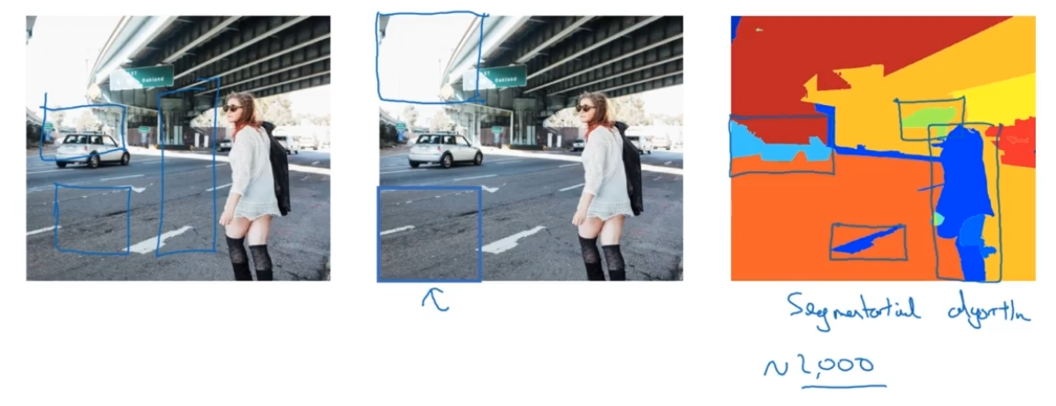
R-CNN – Example of Regional Proposal
Andrew Ng

Slide 27
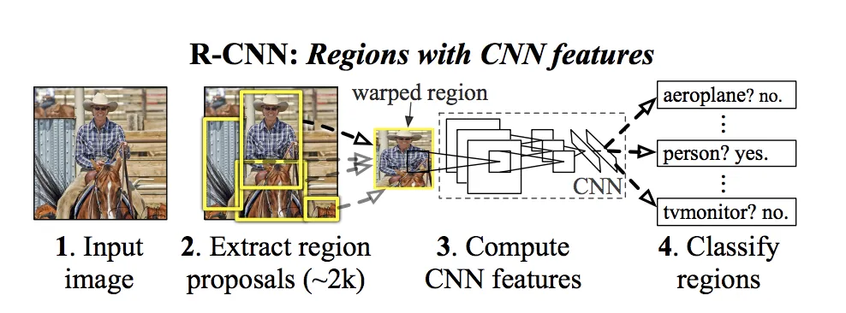
R-CNN: Regions with CNN Features

Slide 28
Analysis of R-CNN
To know more about the selective search algorithm, follow this link.
These 2000 candidate region proposals are warped into a square and fed into a convolutional neural network that produces a 4096-dimensional feature vector as output.
The CNN acts as a feature extractor and the output dense layer consists of the features extracted from the image and the extracted features are fed into an SVM to classify the presence of the object within that candidate region proposal.
In addition to predicting the presence of an object within the region proposals, the algorithm also predicts four values which are offset values to increase the precision of the bounding box.
For example, given a region proposal, the algorithm would have predicted the presence of a person but the face of that person within that region proposal could’ve been cut in half.
Therefore, the offset values help in adjusting the bounding box of the region proposal.

Slide 29
Advantages of R-CNN
Accurate Object Detection: R-CNN provides accurate object detection by leveraging region-based convolutional features. It excels in scenarios where precise object localization and recognition are crucial.
Robustness to Object Variations: R-CNN models can handle objects with different sizes, orientations, and scales, making them suitable for real-world scenarios with diverse objects and complex backgrounds.
Flexibility: R-CNN is a versatile framework that can be adapted to various object detection tasks, including instance segmentation and object tracking. By modifying the final layers of the network, you can tailor R-CNN to suit your specific needs.

Slide 30
Disadvantages of R-CNN
Computational Complexity: R-CNN is computationally intensive. It involves extracting region proposals, applying a CNN to each proposal, and then running the extracted features through a classifier. This multi-stage process can be slow and resource-demanding.
Slow Inference: Due to its sequential processing of region proposals, R-CNN is relatively slow during inference. Real-time applications may find this latency unacceptable.
Overlapping Region Proposals: R-CNN may generate multiple region proposals that overlap significantly, leading to redundant computation and potentially affecting detection performance.
R-CNN is Not End-to-End: Unlike more modern object detection architectures like Faster R-CNN, R-CNN is not an end-to-end model. It involves separate modules for region proposal and classification, which can lead to suboptimal performance compared to models that optimize both tasks jointly.

Slide 31
Problems with R-CNN
It still takes a huge amount of time to train the network as you would have to classify 2000 region proposals per image.
It cannot be implemented real time as it takes around 47 seconds for each test image.
The selective search algorithm is a fixed algorithm.
Therefore, no learning is happening at that stage.
This could lead to the generation of bad candidate region proposals.

Slide 32
Faster R-CNN Algorithms
R-CNN | Propose regions. Classify proposed regions one at a time. Output label + bounding box.
Fast R-CNN | Propose regions. Use convolution implementation of sliding windows to classify all the proposed regions.
Faster R-CNN | Use convolutional networks to propose regions.

Slide 33
Fast R-CNN
A faster object detection algorithm was proposed to solve some of the drawbacks of R-CNN.
It was called Fast R-CNN.
The approach is similar to the R-CNN algorithm, but, instead of feeding the region proposals to the CNN, the input image was used in the CNN to generate a convolutional feature map.
From the convolutional feature map, we identify the region of proposals and warp them into squares and by using a RoI (Region of Interest) pooling layer we reshape them into a fixed size so that it can be fed into a fully connected layer.
From the RoI feature vector, we use a softmax layer to predict the class of the proposed region and also the offset values for the bounding box.

Slide 34
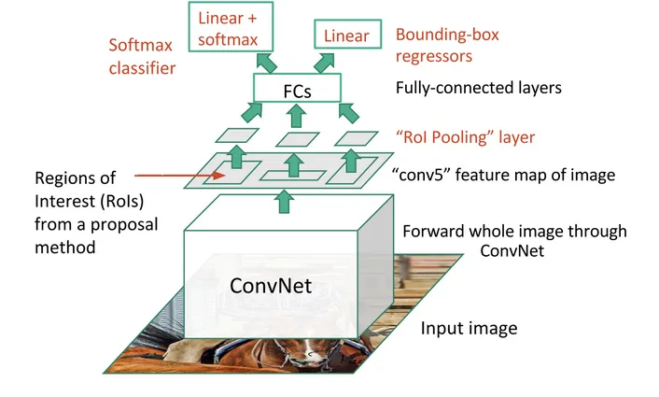
Region of Interest (RoI)
Region of Interest (RoI) pooling is used for utilizing single feature map for all the proposals generated by RPN (Region Proposal Networks) in a single pass.
RoI pooling solves the problem of fixed image size requirement for object detection network.
The entire image feeds a CNN model to detect RoI on the feature maps.
The entire image feeds a CNN model to detect RoI on the feature maps. Each region is separated using a RoI pooling layer and it feeds fully-connected layers. This vector is used by a softmax classifier to detect the object and by a linear regressor to modify the coordinates of the bounding box.

Slide 35
Semantic Segmentation

Slide 36
Semantic Segmentation
Semantic segmentation is a deep learning algorithm that associates a label or category with every pixel in an image.
It is used to recognize a collection of pixels that form distinct categories.
For example, an autonomous vehicle needs to identify vehicles, pedestrians, traffic signs, pavement, and other road features.
Semantic Segmentation is a computer vision task in which the goal is to categorize each pixel in an image into a class or object.
The goal is to produce a dense pixel-wise segmentation map of an image, where each pixel is assigned to a specific class or object.

Slide 37
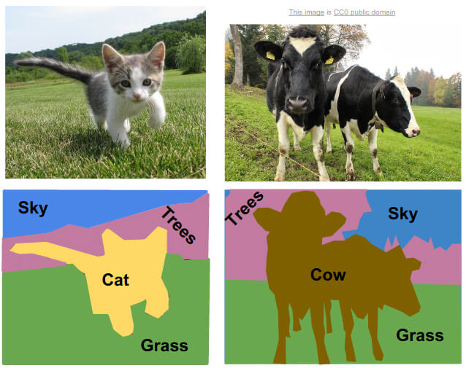
Semantic Segmentation Examples

Slide 38
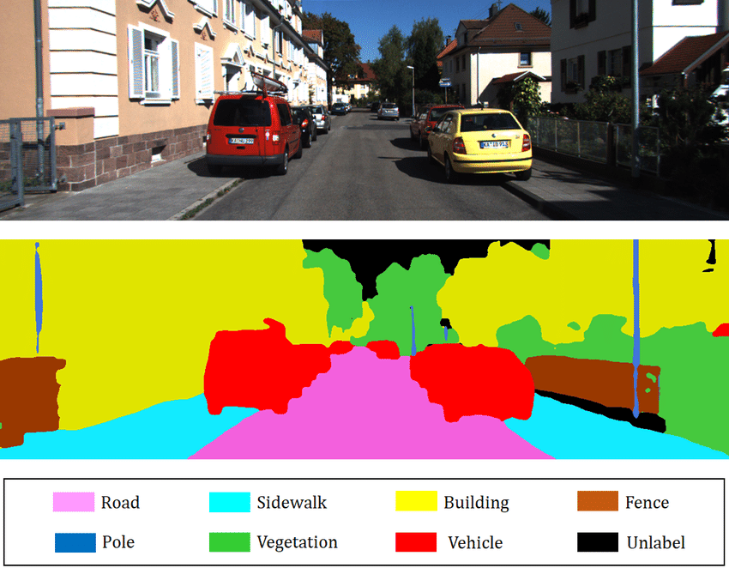
Semantic Segmentation Examples

Slide 39
Object Detection vs Semantic Segmentation

Slide 40
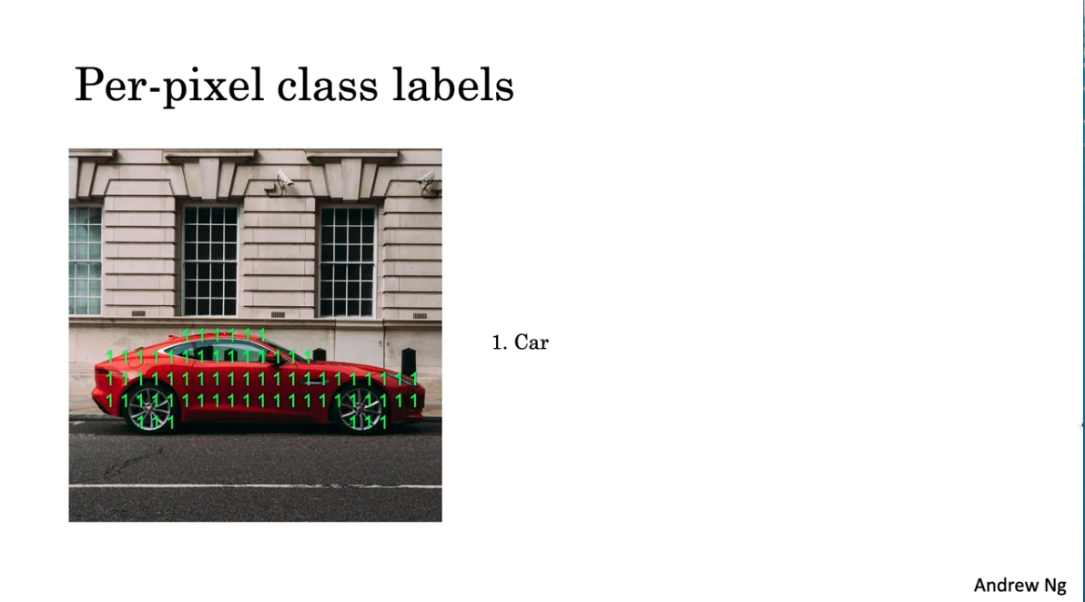
Per-Pixel Class Labels
This method refers to assigning a class label to every individual pixel in an image.
In this case, every pixel is treated independently, and the model predicts what class that pixel belongs to, based on the input features at that pixel's location.

Slide 41
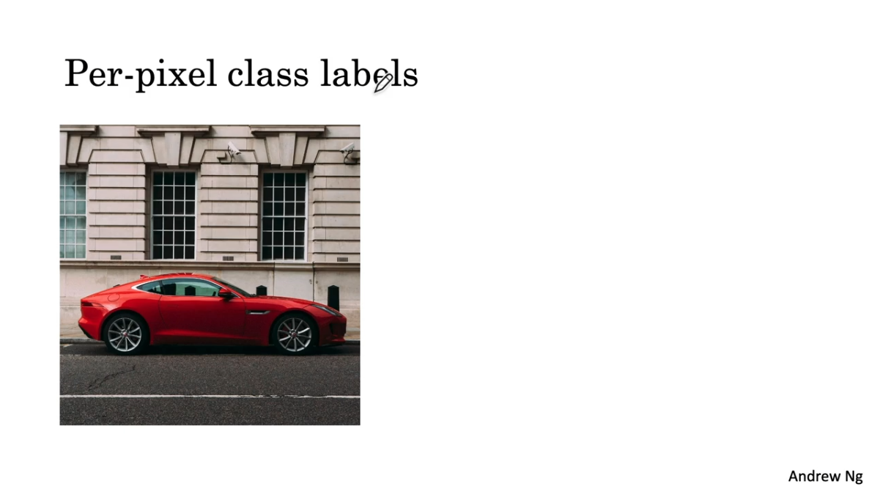
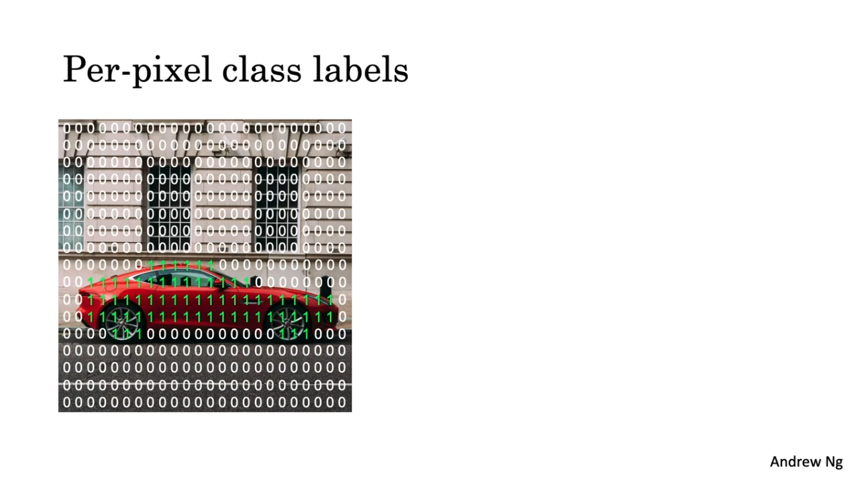
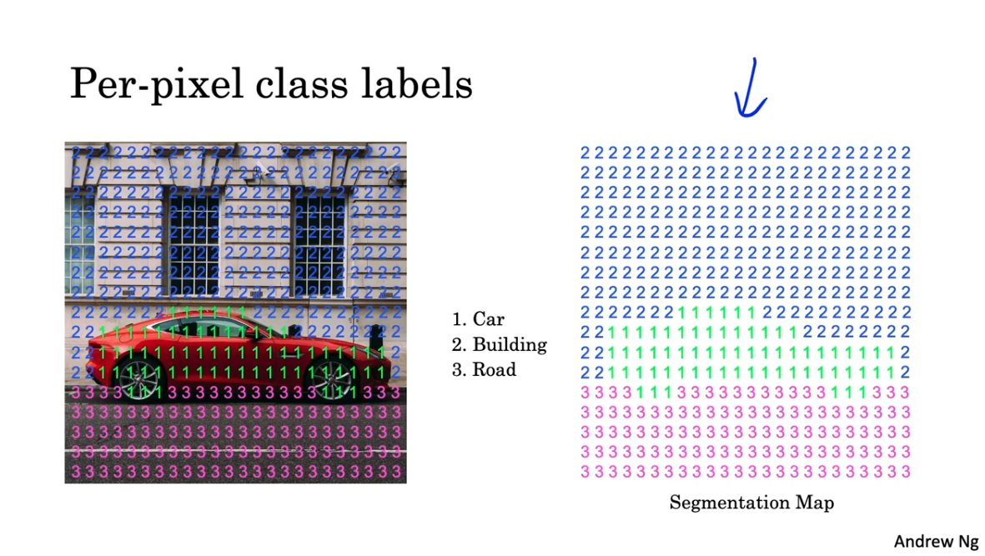
Per-Pixel Class Labels
This method refers to assigning a class label to every individual pixel in an image.
In this case, every pixel is treated independently, and the model predicts what class that pixel belongs to, based on the input features at that pixel's location.

Slide 42
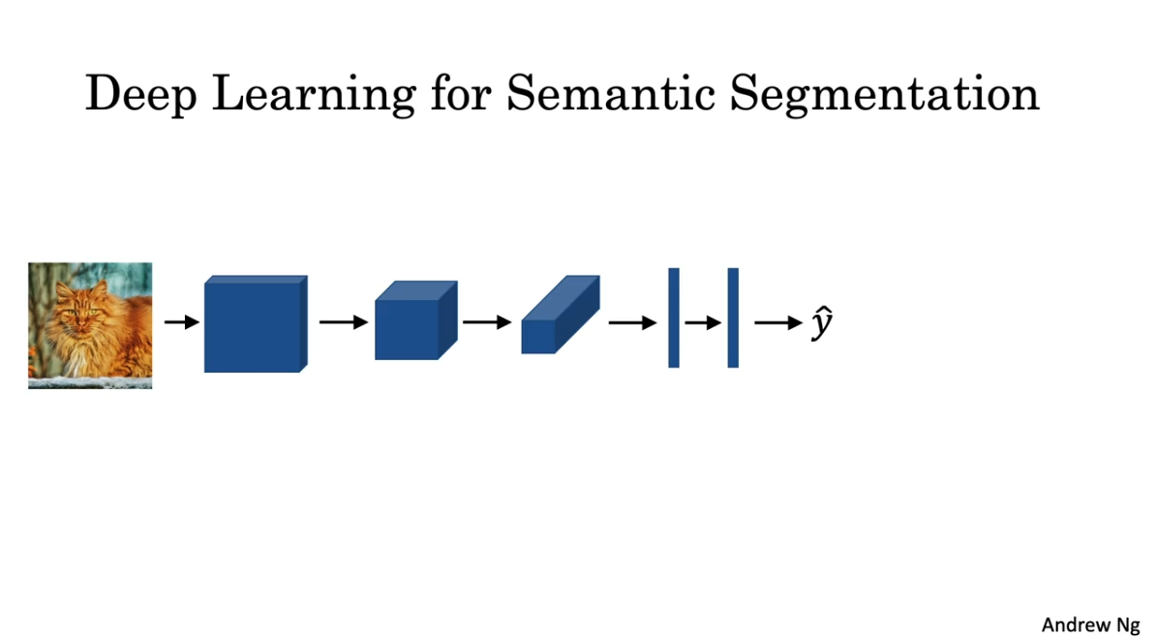
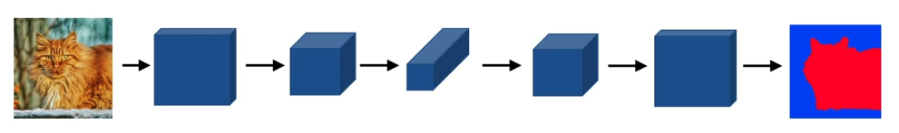
Deep Learning for Semantic Segmentation
The size of convolution layer get smaller and depth greater.
The last FC layers are removed and
The series of new convolution layers are symmetrically added with a growing size and reduced depth.

Slide 43
Transposed Convolution (1/2)
Basic transposed convolution operation with stride of 1 and no padding
Suppose that we are given a n_{h} x n_{w} input tensor and a k_{h} x k_{w} kernel.
Sliding the kernel window with stride of 1 n_{w} for times in each row and n_{h} times in each column yields a total of n_{h}n_{w} intermediate results.
Each intermediate result is a (n_{h} + k_{h} = 1) x (n_{w} + k_{w} = 1) tensor that are initialized as zeros.
To compute each intermediate tensor, each element in the input tensor is multiplied by the kernel so that the resulting k_{h} x k_{w} tensor replaces a portion in each intermediate tensor.
Note that the position of the replaced portion in each intermediate tensor corresponds to the position of the element in the input tensor used for the computation.
In the end, all the intermediate results are summed over to produce the output.
https://d2l.ai/chapter_computer-vision/transposed-conv.html

Slide 44
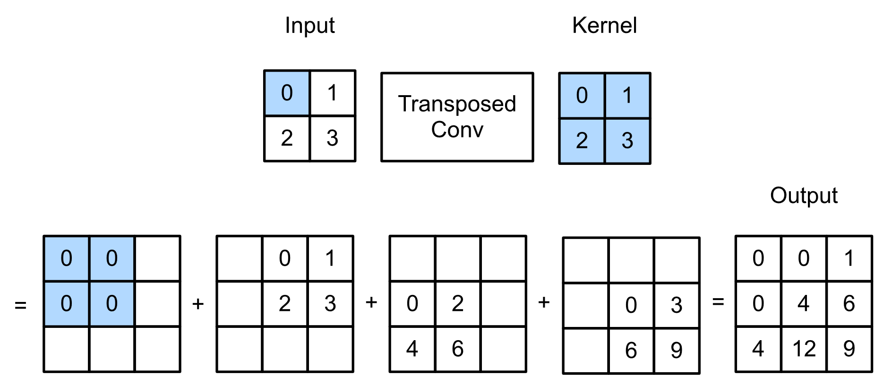
Transposed Convolution (2/2)
This example illustrates how transposed convolution with a 2 x 2 kernel is computed for a 2 x 2 input tensor.
https://d2l.ai/chapter_computer-vision/transposed-conv.html

Slide 45
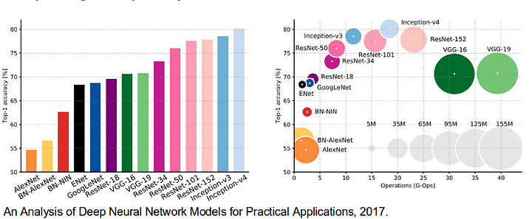
Analysis of DNNs for Semantic Segmentation

Slide 46
Sense of Deep Learning for Semantic Segmentation
Normal convolution
Transposed convolution

Slide 47
Sense of Deep Learning for Semantic Segmentation
Skip convolution to pass high resolution image features to the resized image with extracted features
Normal convolution
Transposed convolution

Slide 48
Sense of Deep Learning for Semantic Segmentation
Skip convolution to pass high resolution image features to the resized image with extracted features
Pass special features and contextual information to the resized image
Normal convolution
Transposed convolution

Slide 49
U-Net

Slide 50
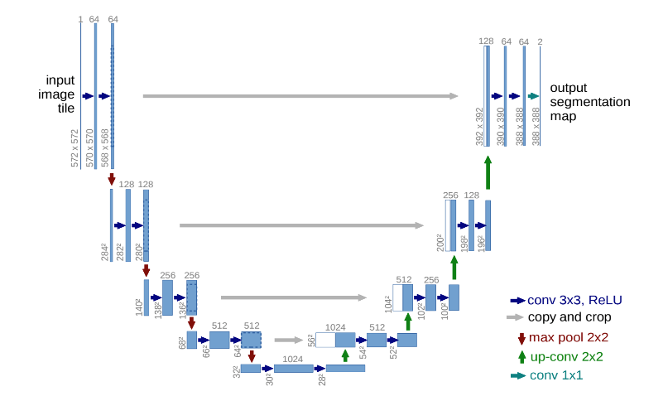
U-Net
U-Net is a convolutional neural network that was developed for biomedical image segmentation at the Computer Science Department of the University of Freiburg.
The network is based on a fully convolutional neural network whose architecture was modified and extended to work with fewer training images and to yield more precise segmentation.
Segmentation of a 512 × 512 image takes less than a second on a modern GPU.
The U-Net architecture has also been employed in diffusion models for iterative image denoising.

Slide 51
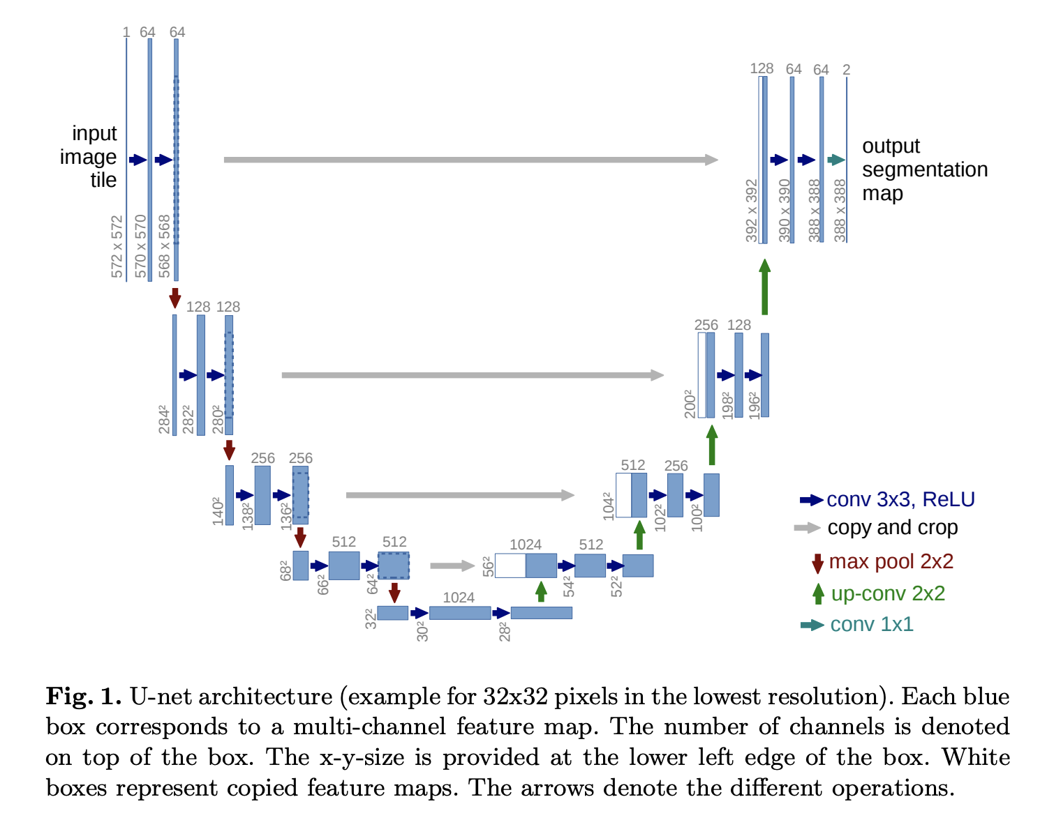
U-Net Architecture (2/4)

Slide 52

U-Net Architecture (2/3)
U-Net is an architecture for semantic segmentation.
It consists of a contracting path and an expansive path.
The contracting path follows the typical architecture of a convolutional network.
It consists of the repeated application of two 3x3 convolutions (unpadded convolutions), each followed by a rectified linear unit (ReLU) and a 2x2 max pooling operation with stride 2 for downsampling.
At each downsampling step we double the number of feature channels.

Slide 53
U-Net Architecture (3/3)
Every step in the expansive path consists of an upsampling of the feature map followed by a 2x2 convolution (“up-convolution”) that halves the number of feature channels, a concatenation with the correspondingly cropped feature map from the contracting path, and two 3x3 convolutions, each followed by a ReLU.
The cropping is necessary due to the loss of border pixels in every convolution.
At the final layer a 1x1 convolution is used to map each 64-component feature vector to the desired number of classes. In total the network has 23 convolutional layers.

Slide 54
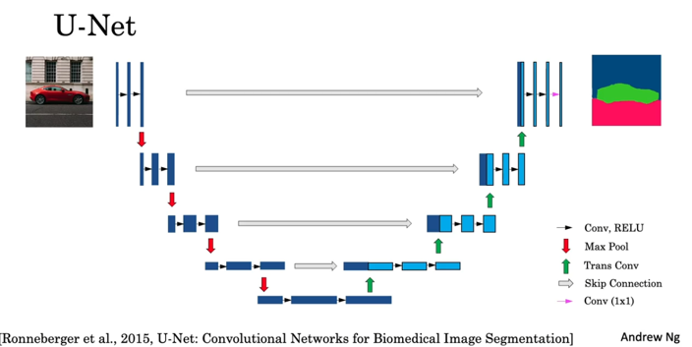
U-Net Example

Slide 55
Chapter 17 – Overlapping Objects and Sematic Segmentation

